Slide 1
Unit 2 Game Specification

Slide 2
Storyline
Umar awakens on a magical journey that begins at the city bus stop and ends at Kampung Sirih, where Tanggang’s mother lives.
At each stage of the trip, Umar must collect energy (bar level on his watch), clues, and words to continue traveling — by bus, train, and kayak, before finally walking to the village.
Each stop presents a mini word-learning challenge tied to vocabulary and story context.

Slide 3
Game Overview
Level | Transport Mode | Scene | Gameplay Focus | Learning Outcome
1. Bas Bertolak! | Bus | Urban start point | Picture/Meaning match | Recognize word meanings
2. Kuasa Keretapi | Train | Cross-island travel | Scrambled word formation | Reinforce spelling and visual recall
3. Berkayak ke Kampung Sirih | Ship (kayak) + Walking | Coastal & village | Sentence completion & meaning in context | Apply vocabulary in story setting

Slide 4
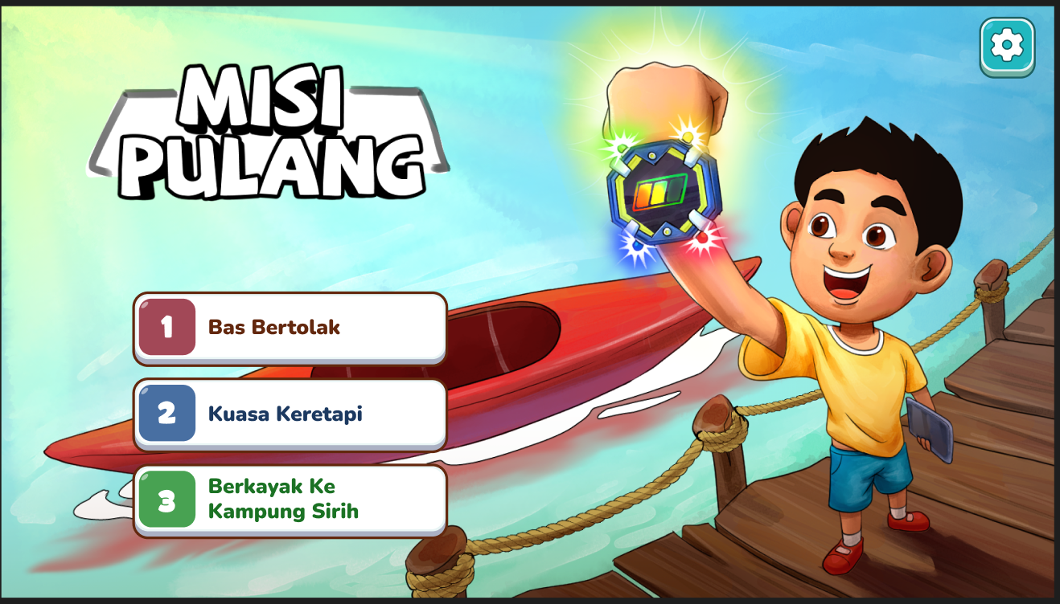
Splash
Client feedback
To ensure font size for all levels are the same
Reply
Artist to note.
Programming to note
All text should be editable by client during UAT

Slide 5
Level 1 – Bas Bertolak!
How to Play
Help Umar complete his bus journey by forming the correct Malay word that matches the picture or meaning shown on the screen.
Gameplay:
  A bus moves across the city road, and each stop shows a picture or short meaning as a clue. (programming to randomize). Refer to Unit 2 Game Content_w MOE inputs for the level 1 game content.
  Below the screen, several scrambled alphabet tiles appear.
  Drag and arrange the letters in the correct order to spell the right Malay word.
  Tap “✓” or press Enter to confirm your answer.
  Avoid guessing randomly — each wrong attempt will delay the bus departure.
  Each correct word helps the bus gain speed and move closer to the train station (next level).
Round setup
  Player to complete 10-word puzzles.
  The 10 Unit 2 words will appear randomly, paired with their matching picture or meaning.
Scoring
+10 per correct answer, +5 speed bonus (complete within 5 sec). Wrong answer, -5. Highest score = 150.

Slide 6
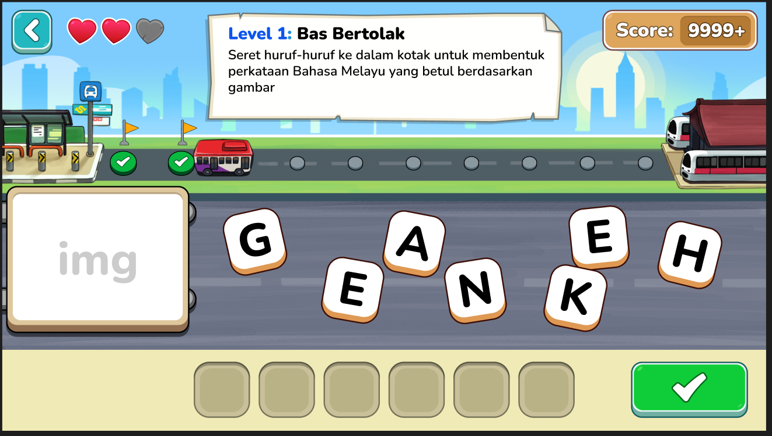
Level 1 – Bas Bertolak!
Client feedback
For this level, how many rounds does the players have before the right answer is revealed?
Game logic requested by Azimah, programmer to note
Allow for 3 tries.
Once player placed all words, they click on the check button.
If wrong, they can try again up to 3 times in total.
The letter(s) placed correctly will remain in the placeholder.
If 3rd try still wrong, their turn ends.

Slide 7
Level 2 – Kuasa Keretapi
Story Context
After completing the bus journey, Umar reaches the train interchange station. The trains are moving in opposite directions — one heading toward the coast, and the other returning inland.
To keep the trains on track, Umar must correctly identify Malay words that match each meaning or sentence clue shown at the top of the screen.
How to Play
Help Umar power the trains by clicking the correct Malay word that matches the meaning or sentence clue shown on the screen (programming to randomize using meaning or sentence clue). Refer to Unit 2 Game Content_w MOE inputs for the level 2 game content.
Gameplay:
  The HUD at the top displays either a short meaning or a sentence cue (e.g., “Terbang lalu berhenti di suatu tempat”).
  Two trains move across the screen on parallel tracks — one left to right, one right to left.
  Each train compartment displays a Malay word card.
  Player must click the correct word before the train passes off-screen.
  Early rounds start with one train only, moving at slow speed.
  Later rounds introduce a second train in the opposite direction and increasing speed, testing attention and vocabulary mastery.
Round setup
  Player to complete 10 rounds total.
  Each round randomly displays one meaning or sentence clue. Distractor words will appear too.
Scoring
+10 per correct answer. Wrong answer, -5. Highest score = 100.

Slide 8
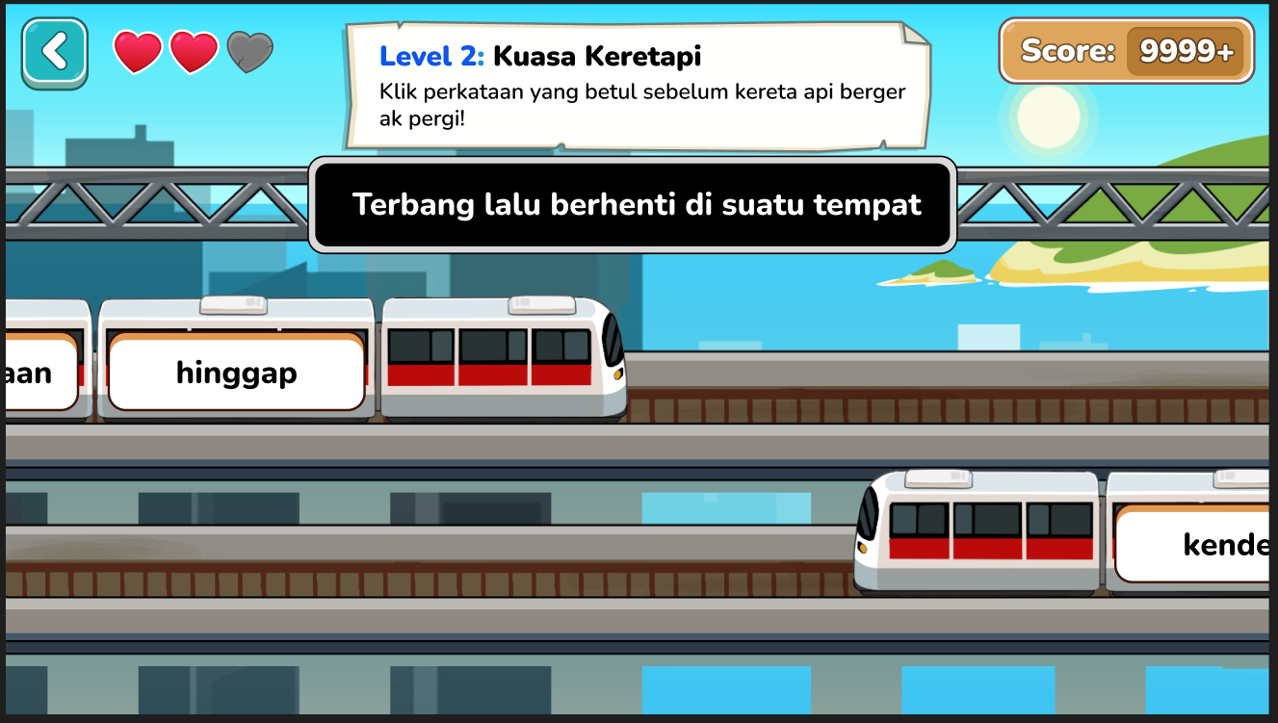
Level 2 – Kuasa Keretapi
Client feedback
The meaning of the word should use sentence cap – meaning first alphabet on sentence is CAP, cannot cap the whole sentence.
Reply
Will update accordingly.
Artist and programmer to note.
Client feedback
During the game, the speed of the train can have variation. At the start slow but it gets faster as the students get more answers correct.
Reply
Yes, this is how we are programming it.
Programmer to note.

Slide 9
Level 3 – Berkayak ke Kampung Sirih
Story Context
After fixing the train system, Umar finally reaches the coastline.
To get to Kampung Sirih, he must paddle a kayak across the river while answering questions that help Tanggang seek forgiveness from his mother.
Each correct answer pushes the kayak forward; wrong answers make it drift back slightly.
How to Play
Help Umar paddle the kayak safely to the village by dragging the correct word into the blank space in each sentence.
Gameplay:
  A HUD at the top shows a short sentence with one missing word (e.g. “Ibu Tanggang ______ haiwan-haiwan yang mematuk Tanggang.”).
  Below, 3–4 word tiles appear (e.g. menghalau, menyesal, terbeliak, terpinga-pinga).
  Player drags and drops the correct Malay word into the blank.
  Each correct drop moves the kayak forward across the water toward the village jetty.
  Wrong answers cause a light ripple animation and slight backward drift.
  The game ends when the kayak reaches the wooden jetty at Kampung Sirih.
Round setup
  Player to complete 10 rounds total.
  Each round randomly displays one meaning or sentence clue. Distractor words will appear too.
Scoring
+10 per correct answer. Wrong answer, -5. Highest score = 100.

Slide 10
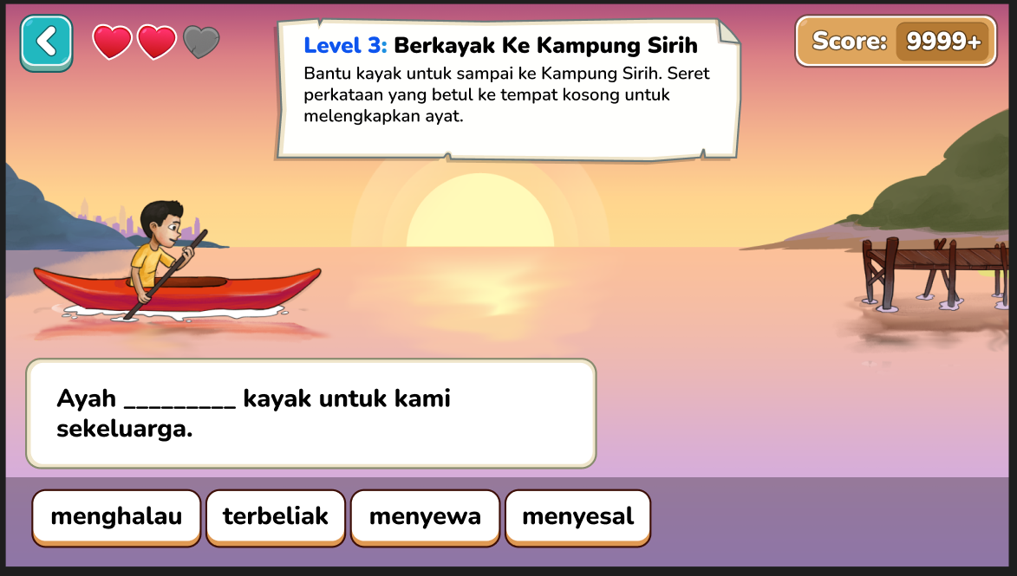
Level 3 – Berkayak ke Kampung Sirih
Client feedback
For the game, I guess the boat will shift nearer to the “dock” as the right answers are provided? Correct?
Reply
Yes, this is how we are programming it.
Programmer to note.

